Slide 1




Fitting the pieces together:
Examining the Findings of a Collections Green Audit
Paige Roman
David McCord
Jax Cato
Samuel Cassady
Liz Mantz

Slide 2



AGENDA
1
Introduction
Background
2
3
Findings
Moving Forward
4

Slide 3


SSHRC Explore Grant
The Green Audit Project is supported in part by funding from the Social Sciences and Humanities Research Council.

Slide 4



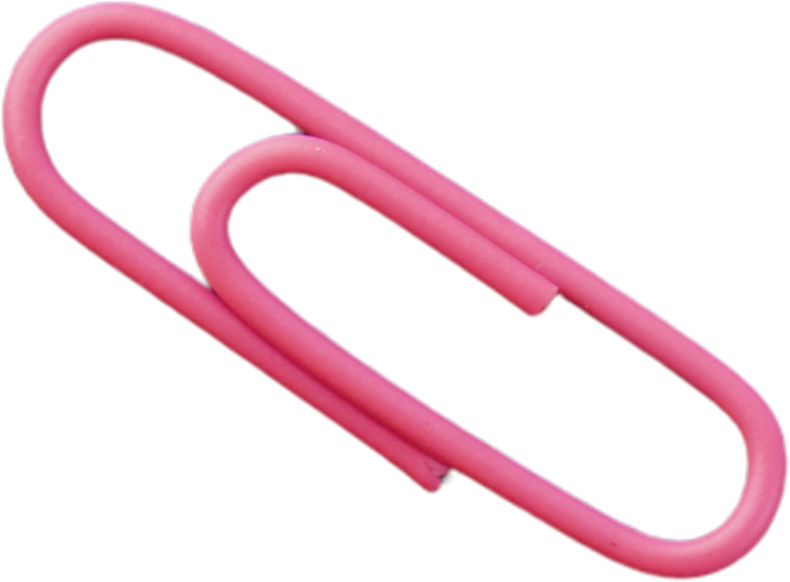
In 2023, Western University ranked in the Top 10 globally:
  QS University Rankings in Sustainability
(10 out of 1,403 institutions)
  Times Higher Education Impact rankings
(9 out of 1,700 universities)
Sustainability embedded in Western’s Strategic Plan Towards Western at 150
University tracks progress across 17 United Nations Sustainable Development Goals (UNSDGs)
SUSTAINABILITY
AT WESTERN

Slide 5



WHY A GREEN AUDIT?
To examine the impact of collections and content purchasing for academic collections using a sustainability lens
“Three E’s” of Environmental Sustainability : Equity, Ecology and Economy
Rubric created to guide and track findings over time
Research website for knowledge exchange

Slide 6


BACKGROUND
Disadvantaged and marginalized people are disproportionately impacted by climate change
6,132
Fires
16.5 million
hectares of land
Canadian Context:
  Indigenous populations
  Racialized populations
  People with disabilities
  People living in poverty, unhoused, etc.

Slide 7



UNIVERSITY PERSPECTIVE
Mission
Rankings
Preparedness

Slide 8



Resources
  Availability of information
  Print vs digital
  Human aspect
PUBLISHING INDUSTRY
Factors
  Industry initiatives
  What’s in their control?

Slide 9


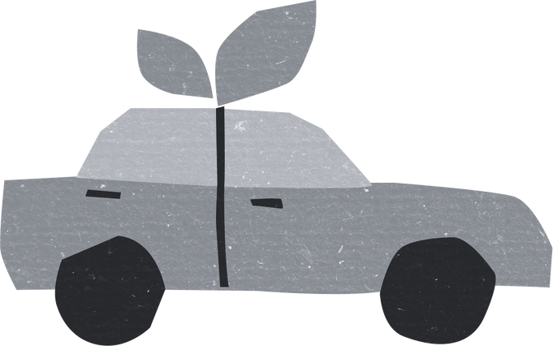
WESTERN STATISTICS
50% ​
of print material has 0 loans
186,354​
print books purchased
40 cars ​
driven for 1 year
Data collected between 2011-2019​

Slide 10

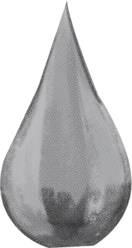
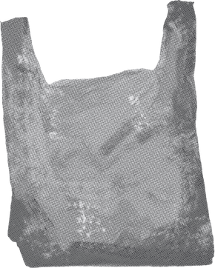
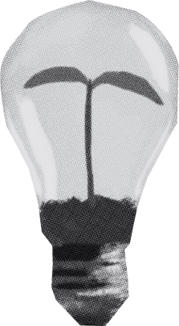
LITERATURE
REVIEW
methodology
trends
our contribution
  Classic databases
  Keywords
  difficulties
  Number of articles
  Topics
  Research needed
  Fills a gap
  Evaluation

Slide 11



AUDIT PROCESS
Selection
Audit
Future
Number of Publishers
Subjects
Webpages
Quality Control
Rubric categories
Excel
Follow-up audit
Accountability

Slide 12
PUBLISHER FINDINGS
16 publishers
44%
UK/EU
31%
US
25%
CA
69% Private
31% Public
100% print
+ digital*
93% multidisciplinary
31% University presses

Slide 13
Sustainable Paper
Geographic Policies
  United Nations Climate Change Conference (COP26)
  International Financial Reporting Standards (IFRS) Sustainability Disclosure Standards
  International Sustainability Standards Board
  Mandatory ESG disclosure
KEY FINDINGS

Slide 14


OTHER FINDINGS
37.5%
Publishers with no information
Rubric revisions
  Relying on parent organization
  Lack of disclosure policy
  Combining subsections
  Potential removals

Slide 15

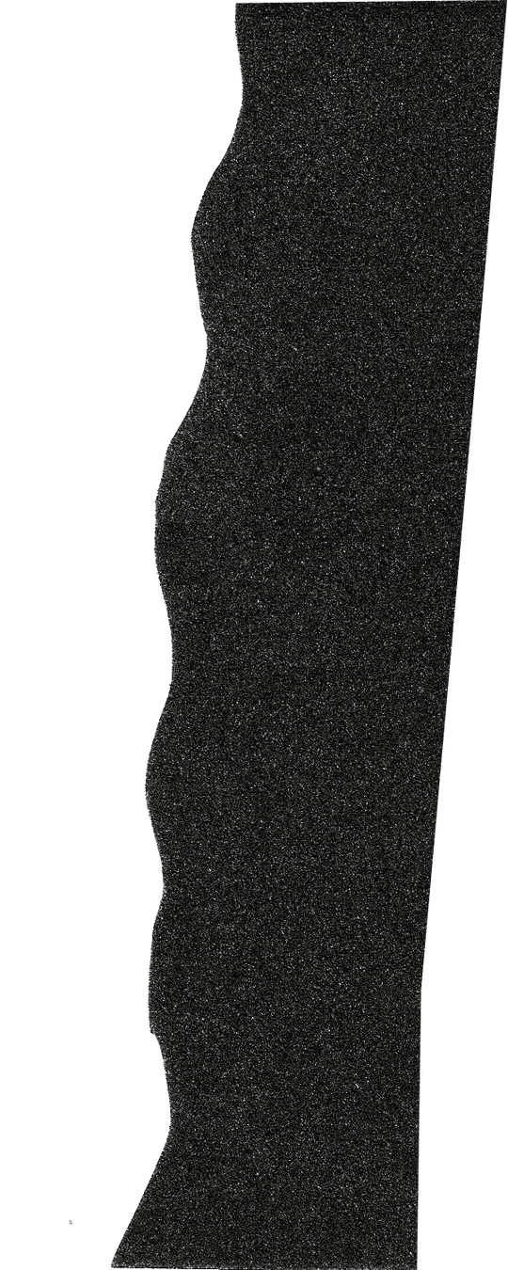
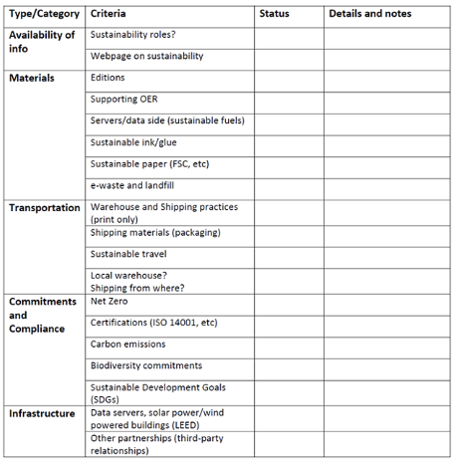
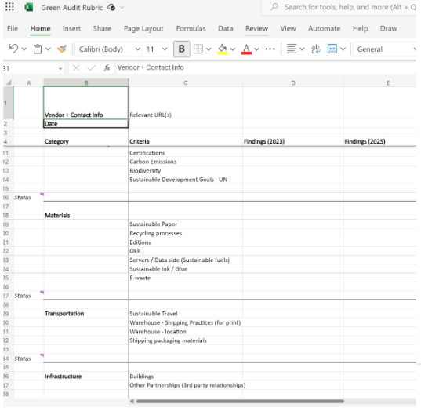

THE RUBRIC - THEN AND NOW

Slide 16
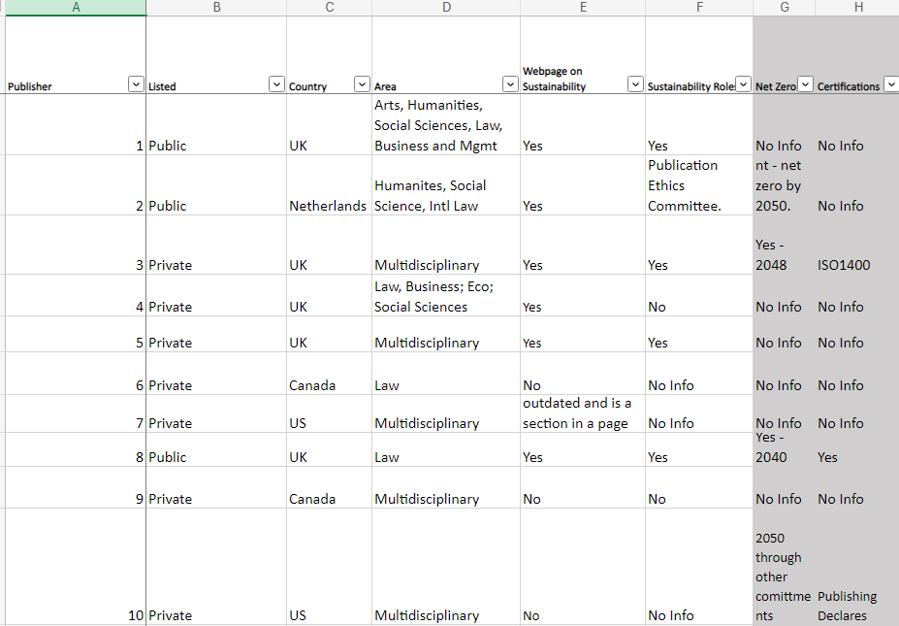


Publishers - At A Glance

Slide 17

SFI
ISSB
IFRS
CDSB
EAC
HESI
PEFC
TCFD
SDS
FSC
LEEDS
SBTi
ESG
REC
CSSB
UNSDG
PREPS

Slide 18
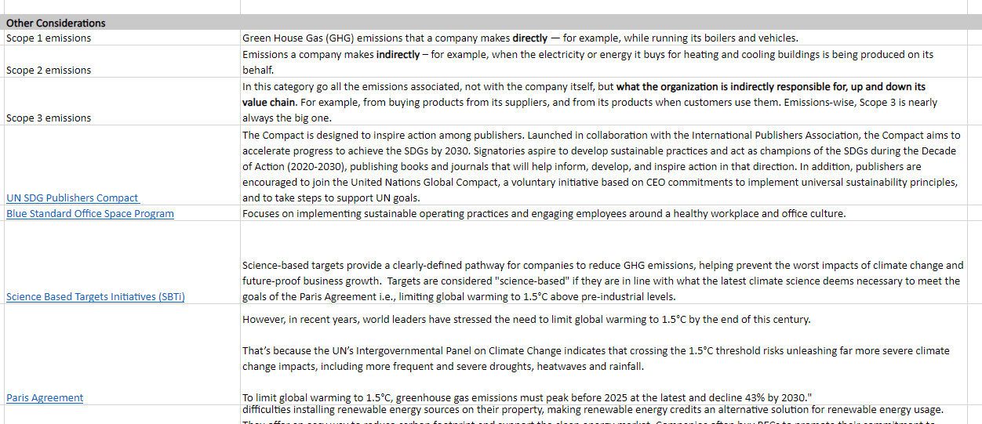

Definitions

Slide 19
WHAT’S NEXT?
  Track and share findings
  Revising the rubric
  Sustainability impacts beyond purchasing (storage and preservation, recycling)
  Collaborative collecting
  Procurement Policy and Supplier Code of Conduct
  Print vs. digital question and accessibility

Slide 20

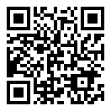
Green Audit Project
https://lib.uwo.ca/greenauditproject

Slide 21

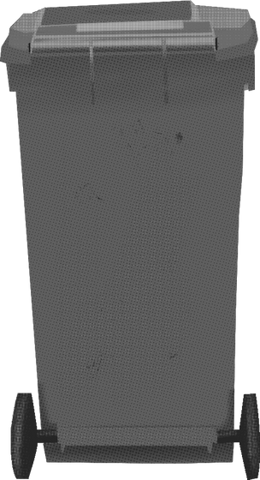

THANK YOU

Slide 22


Questions and Discussion
We invite your questions, thoughts, and ideas.

Slide 23
RESOURCES
Islam, S. N., & Winkel, J. (2017). Climate change and social inequality. United Nations Department of Economic and Social Affairs. https://www.un.org/en/desa/climate-change-and-social-inequality
​
Environmental Protection Agency. (2022, October 11). Greenhouse Gas Equivalencies Calculator. https://www.epa.gov/energy/greenhouse-gas-equivalencies-calculator#results​
Environmental Protection Agency. (2021, September 2). EPA report shows disproportionate impacts of climate change on socially vulnerable populations in the United States. https://www.epa.gov/newsreleases/epa-report-shows-disproportionate-impacts-climate-change-socially-vulnerable
Government of Canada. (2022, November 7). Who is most impacted by climate change. https://www.canada.ca/en/health-canada/services/climate-change-health/populations-risk.html
Sidik, M. A., Shehabi, A., & Marston, L. (2021). The environmental footprint of data centers in the United States. Environmental Research Letters, 16(6), 1-11. DOI 10.1088/1748-9326/abfba1​
​
Western Sustainability. (n.d.-a). ​​How does Western measure up? https://sustainability.uwo.ca/about_us/How%20Does%20Western%20Measure%20Up.html

