Slide 1







STARTING THE CONVERSATION: ASSESSING THE ENVIRONMENTAL IMPACT OF COLLECTION PRACTICES
Paige Roman
Samuel Cassady
Jax Cato
Liz Mantz
David McCord
Notes:
Good morning everyone! Thank you for all coming out to our presentation. It’s my first time presenting at OLA which is exciting. I could talk about sustainability in libraries for hours so feel free to grab me after the presentation if you’d like to talk some more
We have a last minute lineup change, unfortunately our two scheduled publisher representatives couldn’t make it today but we have other representatives for Taylor and Francis and Oxford university press here to fill in!
So our presentation is “starting the conversation: assessing the environmental impact of collection practices” or by its much shorter title that we’ve been calling it, the green audit.
Q: Before we start off, raise your hand if you take environmental impact into consideration when making collections decisions?

Slide 2




Table of Contents
  Introduction
  Situating Western
  Situating the Publishing Industry
  Rubric
  Vendor Perspective
  Moving Forward
Notes:
The presentation is divided into 3 rough sections:
We'll start off with context behind and the development of the green audit rubric, hear the vendor perspectives, and then wrap up what we plan to do next.

Slide 3


INTRODUCTION
Lack of literature
Growing climate concerns
Disproportionate impact
The three E's
Green audit
Notes:
Most of the literature on sustainability in libraries focuses on green buildings, information literacy, and developing collections on sustainability. There isn’t really any literature on sustainable or green practices in collection development outside of developing collections on like environmental engineering.
Given growing climate concerns and the disproportionate impact of climate change on disadvantaged communities, the collections and content strategies team was looking for a practical way to evaluate our selection practices to reduce the impact they have on the environment.
To that end we’ve come up with a kind of collections green audit rubric that kind of grades or collections information from publisher websites to see how sustainable our publishing partners are.
green audits are typically used for assessing the energy and water use in a building, but we’ve adapted the concept to try to capture the environmnetal impact of each stage of book production.
Focus on what we can control. Trying to strike a balance between user needs and the environmental impact of the resources we provide.
This is very much, for us at least, a first step in looking at Western Libraries environmental impact. The rubric and criteria are still being evaluated and changed and we'd love to hear your input at the end of this presentation.

Slide 4

DISPROPORTIONATE IMPACT
"initial inequality causes the disadvantaged groups to suffer disproportionately from the adverse effects of climate change, resulting in greater subsequent inequality" (Islam & Winkel, 2017)
Notes:
For those who didn't know before, disadvantaged and marginalized groups are disproportionately impacted by climate change. The UN Department of Economic and Social affairs published a report that kind of groups the ways that disadvantaged communities are affected:
increased exposure to climate hazards
Increased susceptibility to damage caused by climate hazards
decreased ability to cope with that damage
So some examples of this would be X, Y, Z (Examples from EPA)
In Canada, these groups include:
Indigenous people s
People with disabilities
Those living in poverty, unhoused, etc.

Slide 5

SITUATING WESTERN LIBRARIES
Western University:
Strategic plan
Paris Pledge for Action
Gold Stars rating
Ranked #1 university in Canada and #3 in the world for working towards UN SDGs
What about Western Libraries?
Notes:
So Western University as a whole has a couple initiatives and awards to note:
Sustainability is one of the goals outlines in the strategic plan (year)
Signed the paris pledge for action
Gold stars rating 3 years in a row (expand)
Ranked #1 in Canada and #3 in the world for working towards UN SDGs
So what about western libraries?
We also have sustainability listed as a goal in our strategic plan, but there haven’t really been any widespread green or sustainability initiatives
This project isn’t mandated by the chief librarian or anything, it was something we took up on our own

Slide 6




SITUATING THE PUBLISHING INDUSTRY
Paper
  1-2% of industry carbon emissions
  Biggest user of virgin wood
Digital
  Data centers
  End user
Notes:
One of the challenges we had with this project was collecting statistics on the environmental impact of the publishing industry. There isn’t really one source to look at and you kind of have to look at the lifecycle of a book to understand the full environmental impact.
One of the ways that publishers are measuring their impact is coming up with a CO2e or carbon equivalent calculation for their products.
Q: what do you think has a higher CO2e, print or digital?
Because the processes for creating a print book vs an ebook are so different, it makes sense for us to divide them when looking at the impact
So for the paper industry, obviously theres deforestation, pulp and paper production uses a ton of water and energy.
The paper and pulp industry contributes 1-2% of all carbon emissions globally.
Pulp and paper industry biggest user of virgin wood
For the digital side of things, things get even murkier. What is known is that data centers and servers use a lot of energy to store and perform computations. They get really hot and need to be cooled down.
1% of global energy consumption
Most of the environmental impact of ebooks actually comes from their use rather than their production, which is the opposite of print books.

Slide 7



WESTERN STATISTICS
186,354
Print books purchased
50%
of print material has 0 loans
40 cars
driven for 1 year
Data collected between 2011-2019

Slide 8

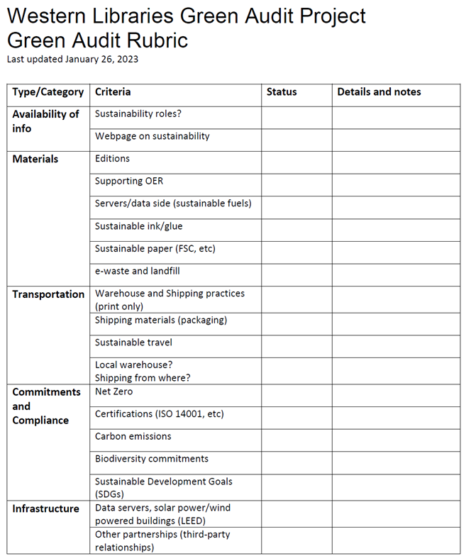


THE RUBRIC
Notes:
-”what you’ve all been waiting for!”
-rubric is currently a living document
-created by the team: a) sifting through what leading publishers are doing, and b) looking for what we view as important and aligned with our institutional goals (might be different for you?)
-would love your feedback – in a few minutes PollEverywhere
-5 high-level categories of criteria, divided into 19 sub-factors
-no “final score” – at this point more about synthesizing what information is/isn’t available

Slide 9
The Rubric
Availability of Info
Sustainability Roles
Dedicated Webpage
Notes:
Sustainability Roles: Dedicated ‘Director of Sustainability’ or ‘Sustainability Manager’ (OUP and TF); also what is companies role? (doing something or providing research?)
Webpage: Does a webpage exist?

Slide 10
The Rubric
2. Materials
Editions
Supporting OER & OA
Servers/Data
Ink/Glue
Paper
Landfill & e-Waste
Notes:
Editions: -Repeating editions for textbooks, etc.; something we’d like to assess but unsure how?
Supporting OER: -Similar to the above, is OA and OER something the publisher is engaged in? Relates to the broader equity component in Sustainability equity for students and the public-good; access to research on sustainability
Servers/Data: -Sustainable fuels to produce products (e.g. Green Hydrogen instead of blue)
Ink/Glue/Paper -Ink and Paper, where are materials sourced? FSC graded paper “When the Forest Stewardship Council® (FSC®) certifies that a paper is made of responsibly sourced wood fiber”
e-Waste & Landfill -strategy for disposing of materials to recycling or to bio-waste to generate energy (e.g. RNG); not just paper products but old technology

Slide 11
The Rubric
3. Transportation
Shipping
Shipping Materials
Travel
Warehouse Locations
Notes:
Shipping: -fleet trucking emissions; forklifts in warehouse
Shipping Materials -alternatives to plastic packaging of journals; recycled paper products
Travel -supports and policies for employees getting to work, but also for assessing need for international travel and in-person meetings (e.g. our UK friends electing to not attend today J)
Warehouse Locations -preference for local production and shipping

Slide 12
The Rubric
4. Commitments & Compliance
Net Zero
Certifications (e.g. ISO 14001)
Carbon Emissions
Biodiversity
Sustainable Development Goals
Notes:
Net Zero: -is there a plan, and by when? Not overnight so by 2030, and then full?
Certifications: -ISO 14001 (“ISO’s environmental standards, the tools for translating passion into effective action. Globally.”)
Carbon Emissions -how much carbon?
Biodiversity -deforestation, tree planting, maintaining sustainable ecosystems
Sustainable Development Goals: United Nations (UN) Global Compact signatory? “an initiative that global corporations can sign on to committing to responsible business practices in the areas of human rights, labor, the environment, and corruption.”

Slide 13
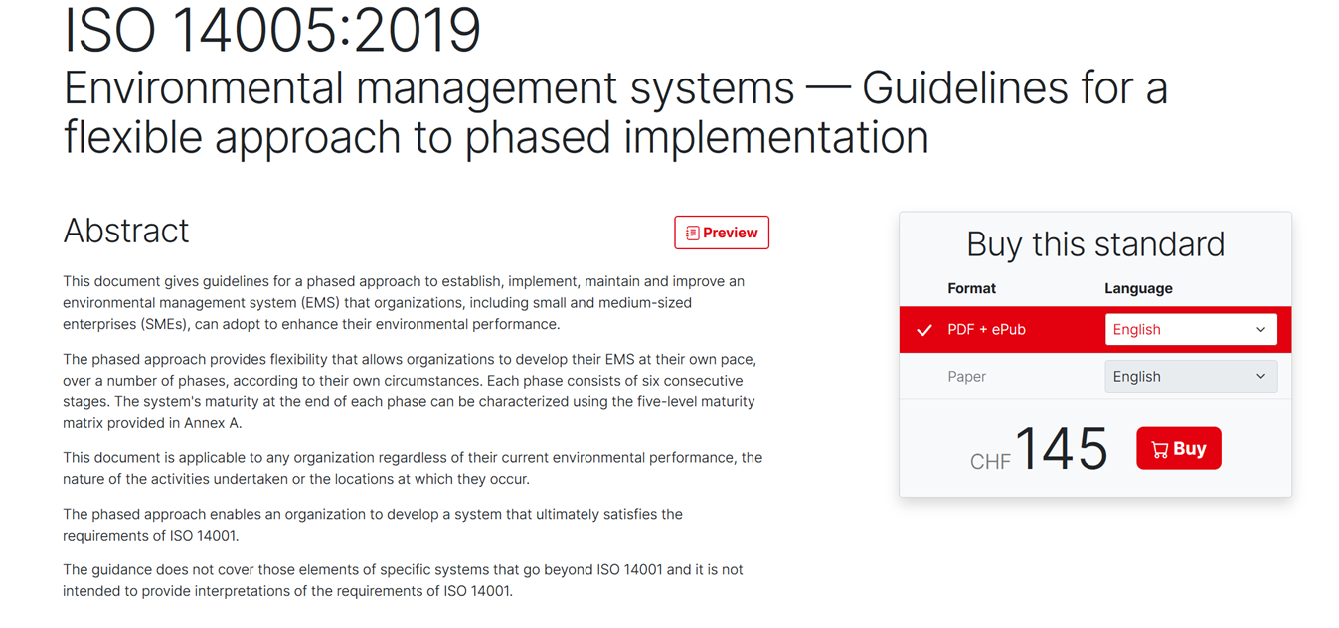

Slide 14
The Rubric
4. Commitments & Compliance
Net Zero
Certifications (e.g. ISO 14001)
Carbon Emissions
Biodiversity
Sustainable Development Goals
Notes:
Net Zero: -is there a plan, and by when? Not overnight so by 2030, and then full?
Certifications: -ISO 14001 (“ISO’s environmental standards, the tools for translating passion into effective action. Globally.”)
Carbon Emissions -how much carbon?
Biodiversity -deforestation, tree planting, maintaining sustainable ecosystems
Sustainable Development Goals: United Nations (UN) Global Compact signatory? “an initiative that global corporations can sign on to committing to responsible business practices in the areas of human rights, labor, the environment, and corruption.”

Slide 15
The Rubric
5. Infrastructure
Building Energy & Power
Other Partnerships
Notes:
Energy & Power: -LEED certified buildings? (e.g. solar power, insulation, materials, water usage, etc)
Other Partnerships: -implications by proxy…. We’re all working in a supply chain (THEME OF PRESENTATION)

Slide 16
The Rubric
What do you think? Please select the criteria that you think are highest priority.
PollEv.com/samuelcassady210

Slide 17
The Rubric
Results...
https://www.polleverywhere.com/ranking_polls/mYbcp0X9a4dFz1Qmabw96?preview=true&controls=none

Slide 18


Moving Forward
Implementing the Rubric
  Tiebreaker
  Leverage
  Advance
Collective Collecting
  Membership
  Sharing
  Consortial EBA

Slide 19
Collaborative Storage
  Various on and offsite institutional storage facilities
  Keep@Downsview
Potential for the Future
  Decrease print and environmental spend
  Controlled Digital Lending

Slide 20
CONCLUSION
The goal is not to ostracize publishers, but to work with them to create a better and more sustainable publishing ecosystem.

Slide 21
Questions?
Email us at greenauditproject@groups.uwo.ca
Project website: https://www.lib.uwo.ca/greenauditproject/

Slide 22
REFERENCES
Environmental Protection Agency. (2021, September 2). EPA report shows disproportionate impacts of climate change on socially vulnerable populations in the United States. https://www.epa.gov/newsreleases/epa-report-shows-disproportionate-impacts-climate-change-socially-vulnerable
Environmental Protection Agency. (2022, October 11). Greenhouse Gas Equivalencies Calculator. https://www.epa.gov/energy/greenhouse-gas-equivalencies-calculator#results
Furszyfer Del Rio, D. D., Sovacool, B. K., Griffiths, S., Bazilian, M., Kim, J., Foley A. M., & Rooney, D. (2022). Decarbonizing the pulp and paper industry: A critical and systematic review of sociotechnical developments and policy options. Renewable and Sustainable Energy Reviews, 167, 1-33. https://doi.org/10.1016/j.rser.2022.112706
Government of Canada. (2022, November 7). Who is most impacted by climate change. https://www.canada.ca/en/health-canada/services/climate-change-health/populations-risk.html
Islam, S. N., & Winkel, J. (2017). Climate change and social inequality. United Nations Department of Economic and Social Affairs. https://www.un.org/en/desa/climate-change-and-social-inequality
Sidik, M. A., Shehabi, A., & Marston, L. (2021). The environmental footprint of data centers in the United States. Environmental Research Letters, 16(6), 1-11. DOI 10.1088/1748-9326/abfba1
Western Sustainability. (n.d.-a). ​​How does Western measure up? https://sustainability.uwo.ca/about_us/How%20Does%20Western%20Measure%20Up.html
Western Sustainability. (n.d.-b). Sustainability commitments. https://sustainability.uwo.ca/paces/sustainability_commitments1/index.html
Notes:
With print publishing, CO2 is released in the process of creating the paper, especially with the heating necessary in the paper process, water is used. But outside of directly paper production, trees are carbon sinks that hold CO2 and also convert it to oxygen
Depending on sources, the paper and pulp industry contributes 1-2% of all carbon emissions globally.
Pulp and paper industry biggest user of virgin wood (https://www.sciencedirect.com/science/article/pii/S1364032122005950)
Want to keep in mind that the supply chain/production of print books bear the brunt of the cost, while for digital, its typically the end-use of a book that creates more carbon output. To this end, we need to be mindful that there are things outside of the publishers
Publishers are not unaware of what is going on and do research into their impacts, sign differect pacts, etc. Not going to delve too far into this because the publishers will talk more about it, I just want to give some general background on the publishing industry and what becomes of their products

